Slide 1
Caching in Snowflake by Janardhan Bandi

Slide 2
Caching
Cache is a temporary storage location that stores copies of files or data, so that they can be accessed faster in near future.
Cache plays vital role in saving costs and speeding up results.
Improves query performance.
2 Types of caches in Snowflake
Query Results Cache
Local Disk Cache

Slide 3
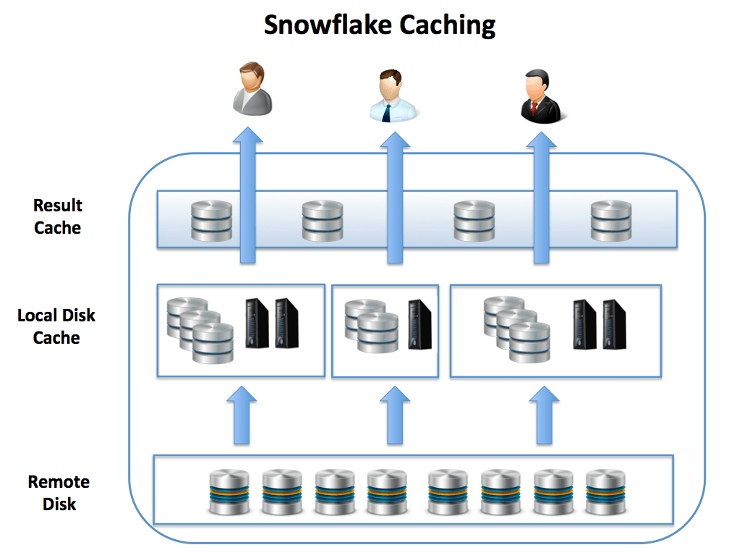
Cloud Layer
Query ‘RESULTS’
(up to 24 hours)
VW Layer
‘DATA’
(until VW is UP and running)

Slide 4
Results Cache
Results Cache is located in cloud services layer. This Cached data will be available for next 24 hours.
Results Cache will be available and can be accessed across different virtual warehouses.
Query results returned to one user is available to any other user on the system who executes the same query.
Results cache works until underlying data has not changed.
Here mandatory condition is query should be same, won’t work for subset of data, and even won’t work if we re-order columns.

Slide 5
Local Disk Cache
Local Disk Cache is located in the Virtual Warehouse (i.e. EC2/VM’s RAM /SSD).
Cache the Data(not the results) fetched by SQL queries.
Whenever data is needed for a given query it's retrieved from the Remote Disk storage, and cached in SSD and memory.
Cached data is only available until the VW is up, once VW is suspended, cache gets deleted.

Slide 6
Local Disk Cache
Even works when we query subset of data that is available in Local disk cache.
Eg. Suppose when we query 10k records for the first time, Local disk cache will hold this 10 k records data and next time if we try to query only 2k or 3k records which is subset of above 10k, it will fetch from Local disk cache itself.
This Cache depends on the Virtual Warehouse Size we are using.
Eg. X-Small VW can’t hold Millions of records, but can fetch part of the data from Local disk cache and remaining from Remote disk.

Slide 7
Thank you

